Slide 2
Aim
I can keep myself safe when I use the Internet.
Success Criteria
I can identify risks when using the Internet.
I understand which things should never be shared online.
I know what to do if I see something online that makes me feel uncomfortable.
This resource is fully in line with the Learning Outcomes and Core Themes outlined in the PSHE Association’s Programme of Study.

Slide 3
The Big Questions

Slide 4
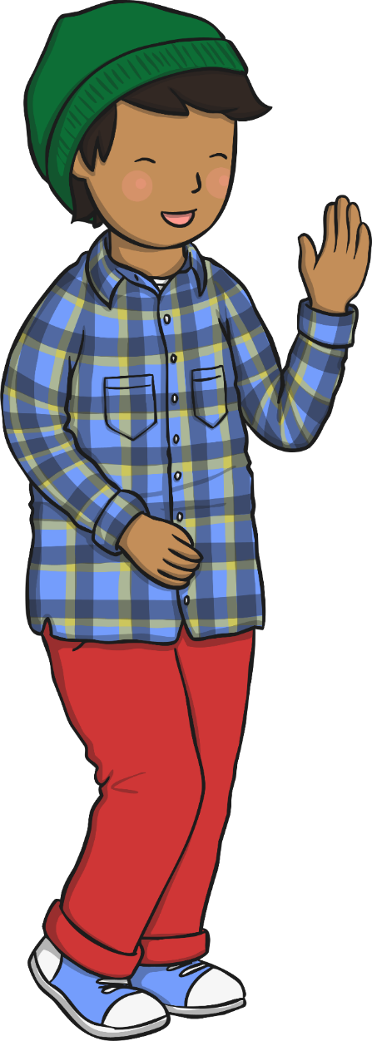
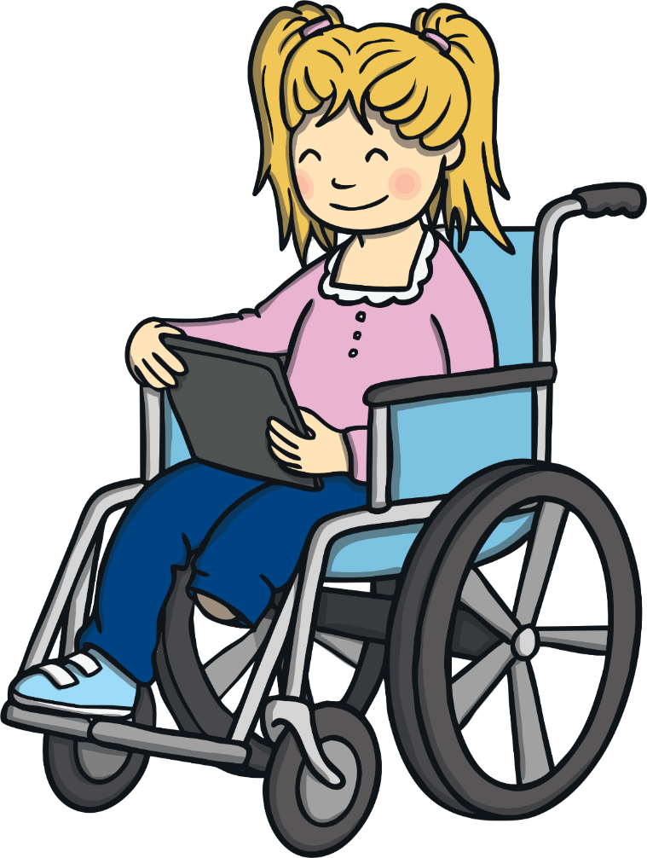
The Big Questions
How can we use the Internet in a safe way?
What rules must we follow when using the Internet?

Slide 5
Reconnecting

Slide 6
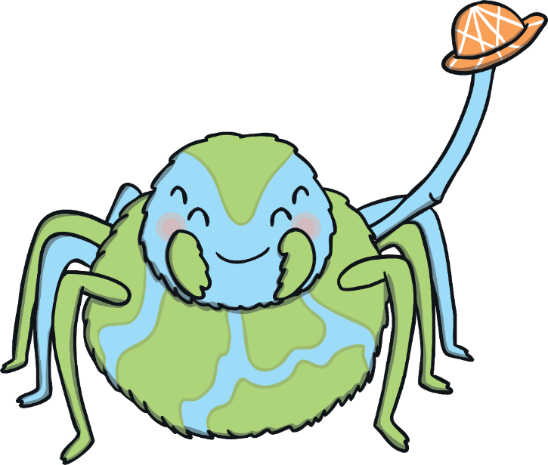
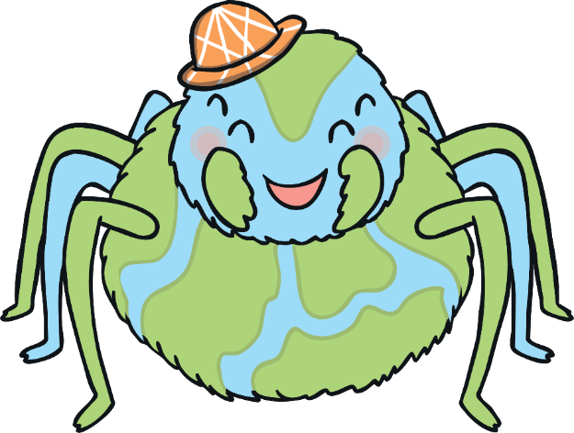
Meet Webster
Let’s meet Webster! He’s the World Wide Web spider and he is here to help us learn about staying safe online.
Hi, kids! It’s great to meet you all!

Slide 7
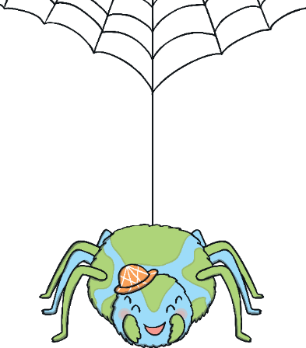
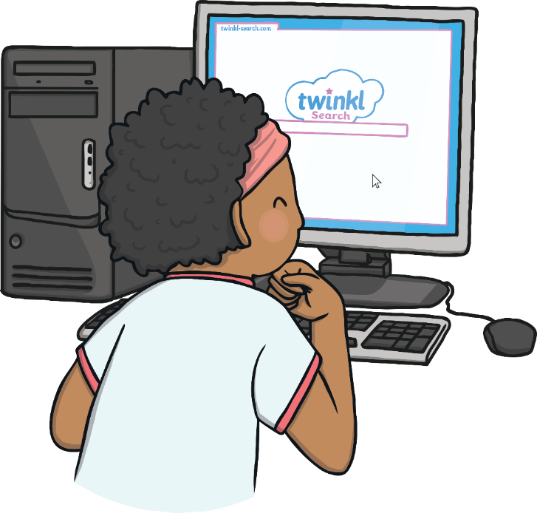
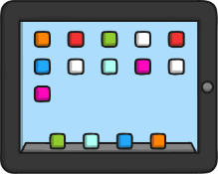
Meet Webster
Many people use the Internet every day. People go online on mobile phones, tablets, laptops and computers – at school, work and at home.
What do you use the Internet for, everyone?

Slide 8
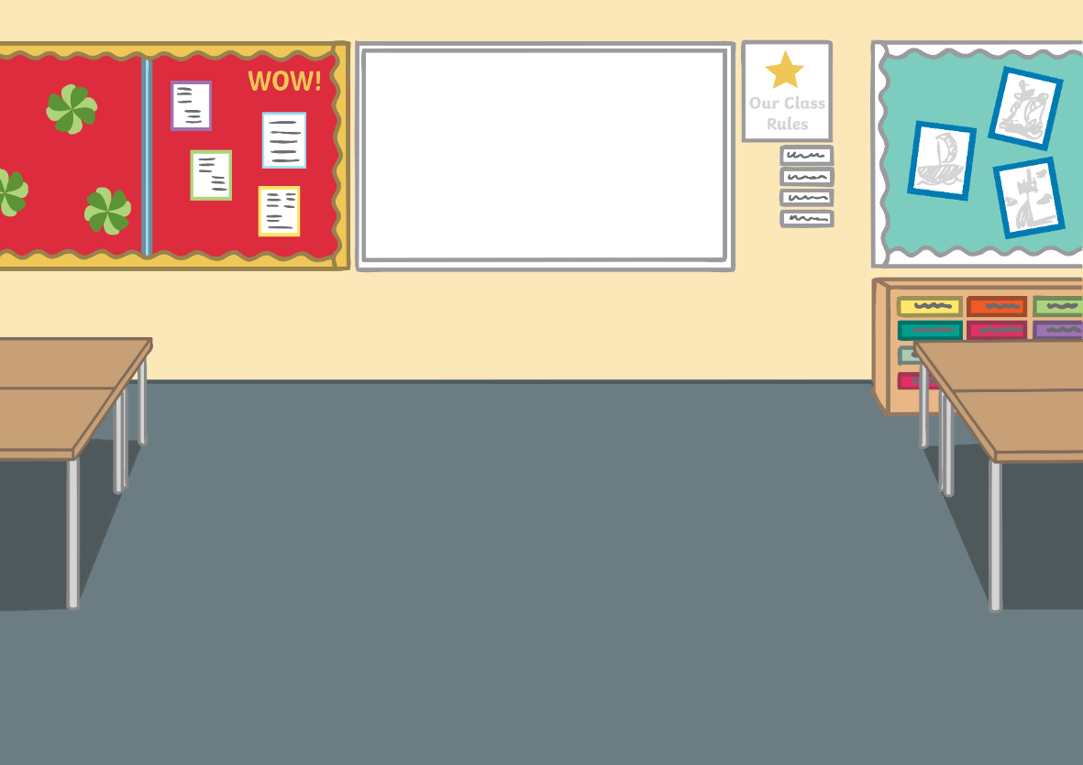
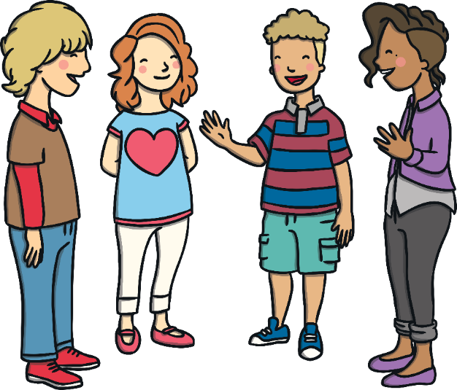
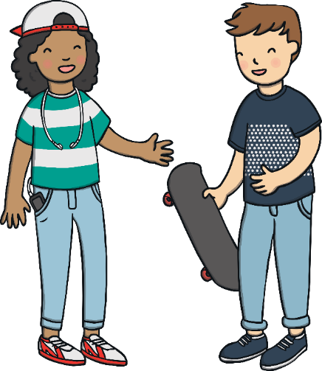
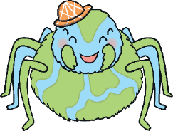
Meet Webster
I play games on my console, with other children, online.
I use the Internet to help me with my homework.
I watch funny videos on my tablet.
I help my mum order the shopping on our tablet.
I chat with my nan on the computer and send her emails. She lives in Spain.
My dad lets me play games on his phone.

Slide 9
Exploring

Slide 10
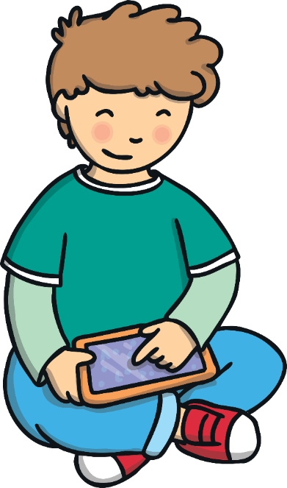
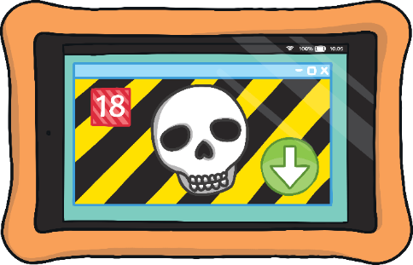
Webster’s Rules
The Internet can be fun and useful but there are some dangers that we need to be aware of.
In life, we have many rules. Rules are there to keep us safe.
Webster has some rules to help keep us safe online. If we learn the rules and follow them, we can avoid the dangers that exist when we use the Internet.
Let’s find out what Webster’s rules are.

Slide 11
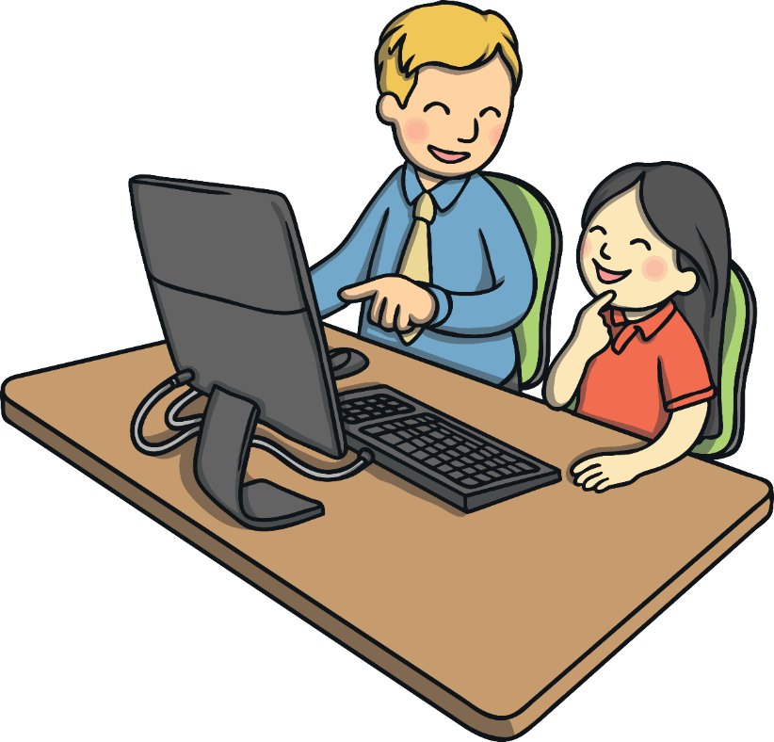
Webster’s Rules
Make sure you get permission and that they are close by in case you need them.
We should always make sure a grown-up knows when we are using the Internet.

Slide 12
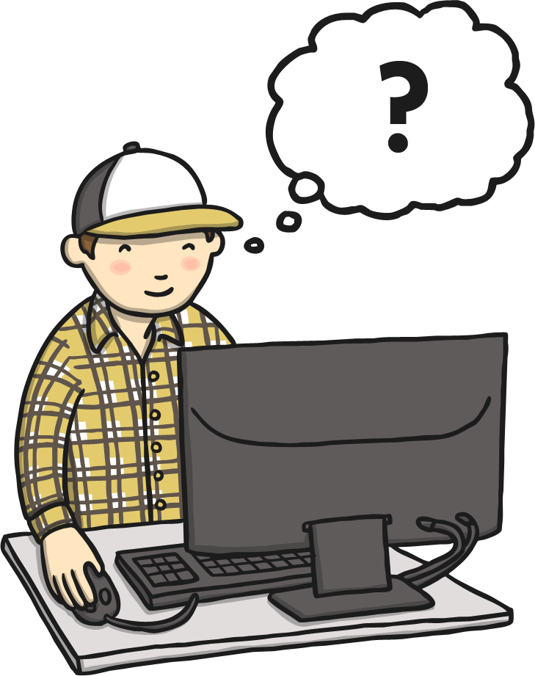
Webster’s Rules
When we enter information on the Internet it is stored. It might get shared with strangers or people we don't want it shared with. Anyone can then share our information with anyone else and we can't stop it from happening.
We must never share our personal information with others online, such as our address, our phone number or the school we go to.
We shouldn’t even use our real name if we are playing games or chatting to others online, unless they are people we already know.
Our private information should stay private.

Slide 13
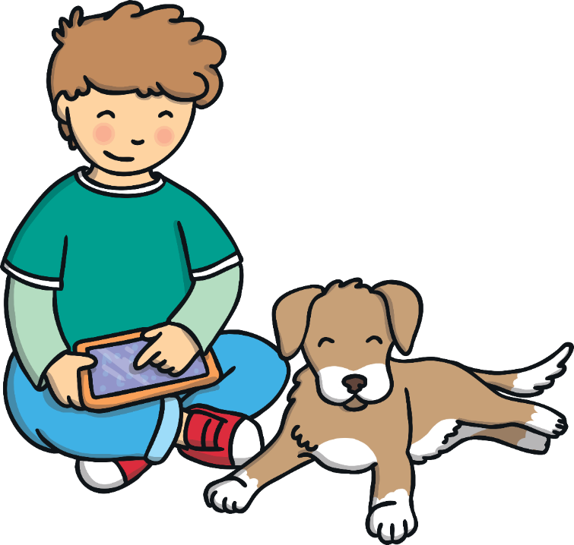
Webster’s Rules
Don’t share your usernames and passwords with anyone other than your parents or carers.
Keep your passwords secret.

Slide 14
Webster’s Rules
Use a safe search engine or ask a grown-up to make sure your computer is only using safe searches, when you look for images and information online.

Slide 15
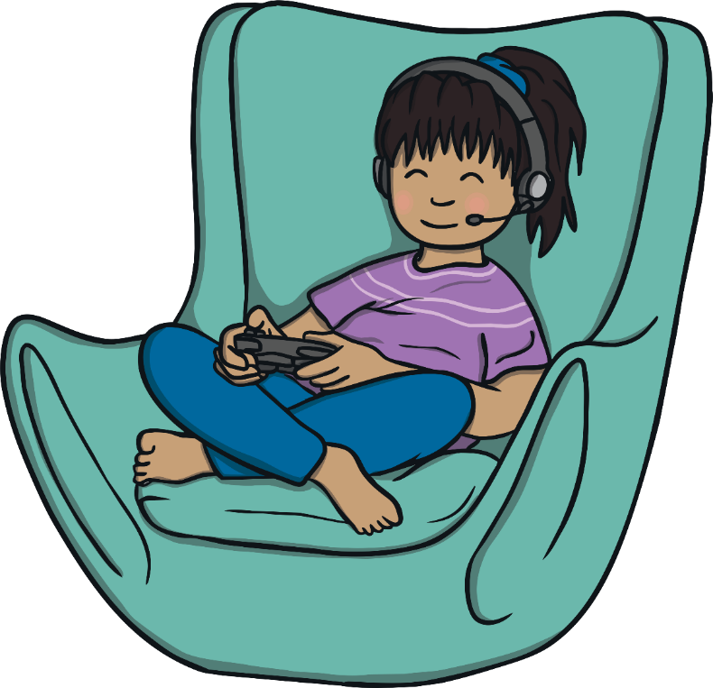
Webster’s Rules
Never arrange to meet someone that you have met on the Internet, even if you think you know them really well or if they seem really nice.

Slide 16
Webster’s Rules
Never share pictures of yourself with a person that you don’t know or you haven’t met.

Slide 17
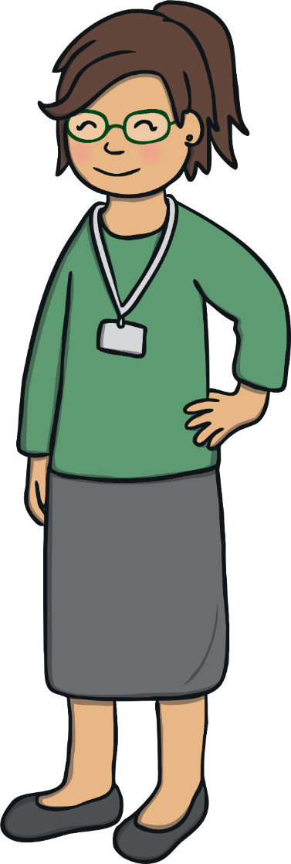
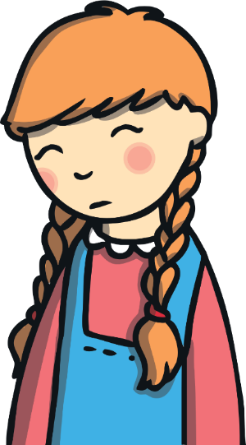
Webster’s Rules
Being mean to others online is a type of bullying, called cyberbullying. If this happens to you, you should tell a trusted adult about it so they can help.
Treat people online with respect and kindness, just as you would do in person.

Slide 18
Webster’s Rules
Always ask a grown-up before you download anything, as it could damage the device you are using.

Slide 19
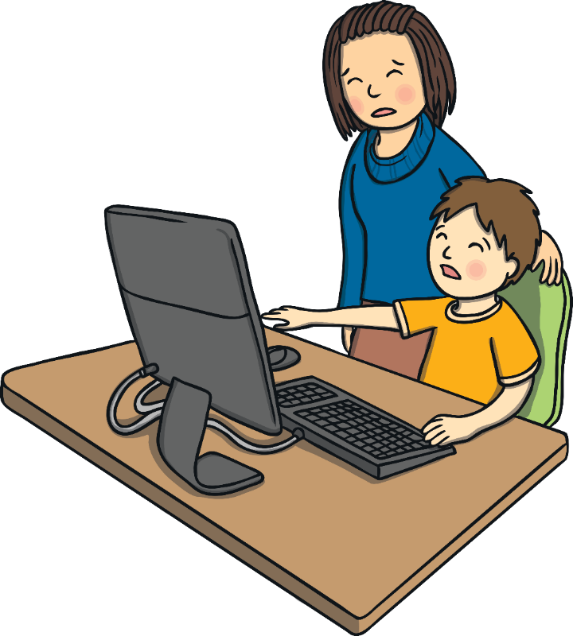
Webster’s Rules
Always tell a trusted adult – like a parent, carer or teacher – if you see anything online that makes you feel worried, scared, upset or confused.

Slide 20
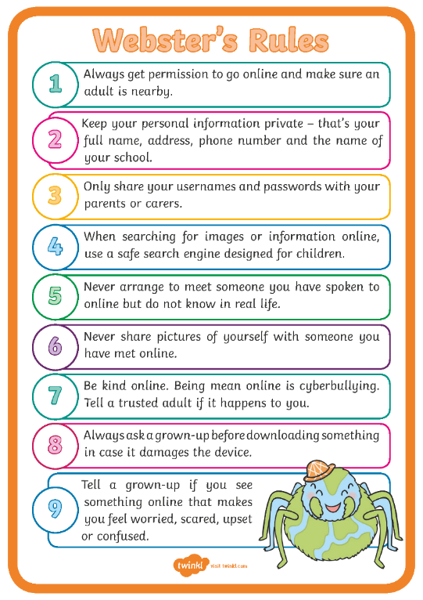
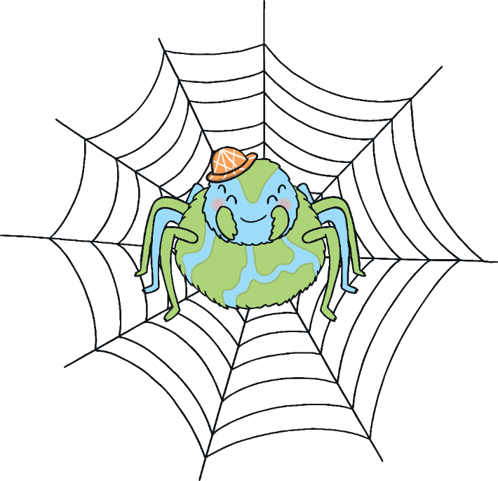
Webster’s Rules
Displaying Webster’s Rules Poster in school will help us to stay safe when we use the Internet.
Webster's rules can help us enjoy the internet safely and use it for all the fantastic things we enjoy about it.
While we do this it is a really good idea to limit the amount of time we spend on it.
Spending excessive amounts of time online can have an impact on our wellbeing by making us not enjoy what is going on around us now.
Enjoy the internet as a hobby, but take part in lots of other fun things too!

Slide 21
The Big Questions

Slide 22
The Big Questions
How can we use the Internet in a safe way?
What rules must we follow when using the Internet?
What have you learnt today that will help you in everyday life?

